Slide 1
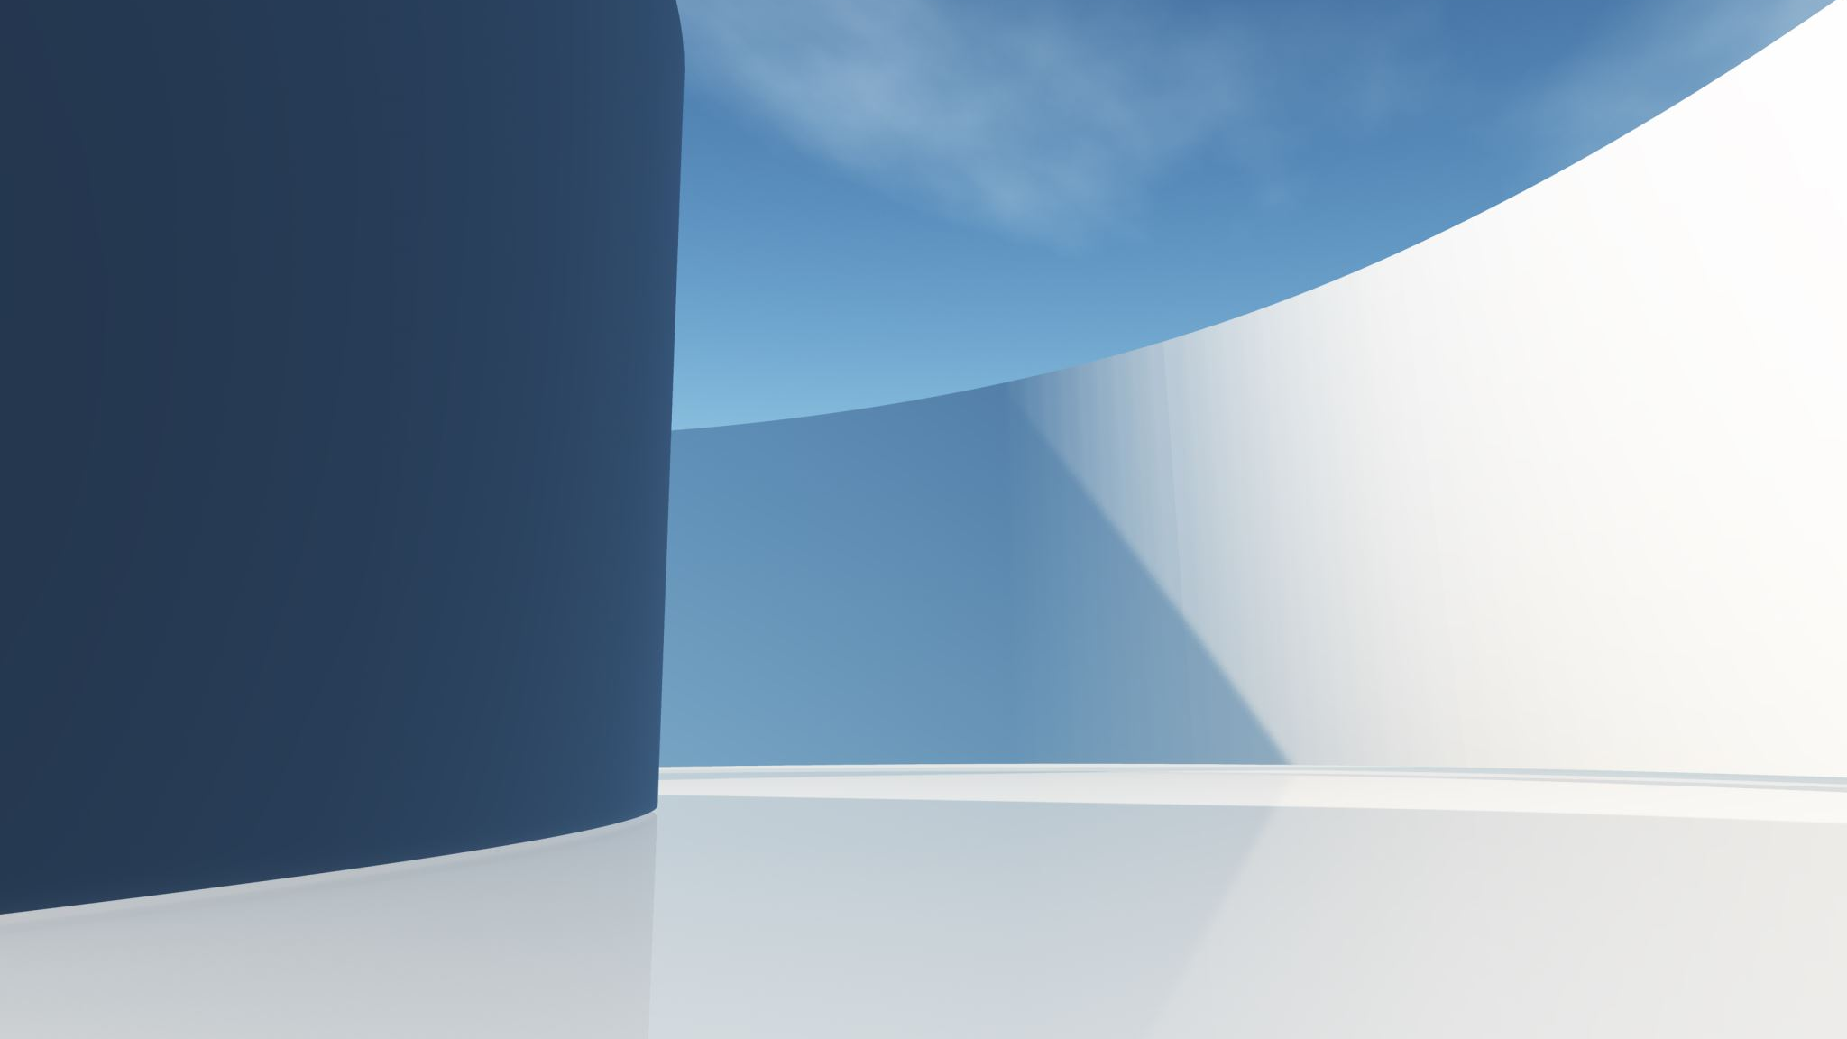
Essential Guidelines for Shura.
Lajna Ima’illah USA Majlis-e-shura September 18-20, 2026.
Chair -Sadr Lajna Ima’illah USA
Dhiya Tahira Bakr ,

Slide 2

Background of Majlis-e-shura
Hadrat Khalifa-tul-Masih V (ayadahullaho ta’ala) delivered an important Friday sermon in 2006 at the occasion of Majlis Mushawarat in Pakistan. He highlighted in some detail the Islamic teachings regarding the Shura and responsibilities of its members. The text of that sermon is also reproduced in the book; Essential Guidelines for Shura.

Slide 3
Object and Importance of Shura (Essential Guidelines for Shura, Wakalat Tabshir)
The objective of mutual consultation is to imbibe the spirit of joint action and cooperate mutually in developing plans for community development.
Hadrat Khalifatul Masih IV rh while addressing the opening of the International Majlis shura on Dec 30, 1982, at Rabwah said: Among the many blessings of Islam, the institution of Shura is a great blessing of excellence.
The institution of Shura is the next most important after the Khalifat, in Islam. (Khalifatul Masih IV rh. Khutba Juma November 12, 1993)

Slide 4
Objectives Of Shura (Essential Guidelines for Shura, Wakalat Tabshir)
The real object of Shura is to agitate the collective Islamic mind so that consequently not one. but the entire collective intelligence will focus at one point to illuminate the central wisdom which has the responsibility to make the final decision. This is the spirit of Shura (International Majlis Shura, Rabwah, December 30, 1982)
According to the Holy Quran the philosophy of Majlis-e-Shura is that in all matters concerning the community the Holy Prophet s.a.w. is told by Allah to consult some of his followers as he pleases, but before he takes the decision, he must consult.

Slide 5
Members/Delegates of Majlis-e-shura
(Essential Guidelines for Shura, Wakalat Tabshir)
We should always elect people who are worthy of the assignment.
Be aware of your responsibilities; elect competent people to represent you.
Elect representatives that excel in taqwa, integrity and worship.
Not one who is long-tongued and a self-promoter but is able to understand an issue and express his/her opinion.

Slide 6
Proposals
Proposals for the Central Shura should be such that are generally of interest to the entire jamaat (auxiliary), the world community or regarding some changes in the system of the jamaat (auxiliary) which again effect the entire worldwide jamaat (auxiliary).
The Amir (National Sadr & Amila) should examine the proposals to determine whether these are at all realistic or only idealistic.
(Essential Guidelines for Shura, Wakalat Tabshir)

Slide 7

Finance Proposal
Finance Sub Committee while discussing the budget must deliberate on the ways and means to increase the income of the jama’at, to establish reserve funds and also how we can decrease the expenses without affecting ongoing projects. (Page-286)
Finance Sub Committee has a right to increase the expenses and also can change the budget. (Page-293)
The System of Mushawarat

Slide 8
Shura Proposals Rejected (Essential Guidelines for Shura, Wakalat Tabshir)
Proposals Rejected are based on:
Technical reasons, received after deadline, forward without initial deliberation at majlis level
Danger of igniting controversy in Jama’at on a fundamental issue
If honor of Jama’at will be compromised
Of a political or rebellious nature
Already underway
Not relevant to the country but of international nature

Slide 9
Shura Procedure: The System of Mushawarat
Amir or National Sadr is Chair of the Majlis-e-Shura and National General Secretary will be the Secretary of Shura
On all the three days of Shura, start with prayer, and a prayer at the end of the concluding session.
When the Chair asks a speaker to stop, they must cease speaking immediately without further argument. (Page 218) 4- It is strictly forbidden to insist upon one's own opinion out of personal pride or emotional attachment. (Page-326) 5 While expressing their opinions, delegates must avoid repetition and speak solely to introduce entirely new arguments. (Page-196
Questions should be asked respectfully to the Chair and in a proper tone. Delegates should be mindful that sometimes not only the content of a question, but also the tone in which it is asked, can create a negative impression. Therefore, all questions should be presented calmly, respectfully, and with dignity. (Page-373)

Slide 10
Shura Procedure (Essential Guidelines for Shura, Wakalat Tabshir)
The Chair will give general guidelines, specify the agenda and will point out what to be mindful of.
Subcommittees will be formed…
Subcommittee should examine the issue, form a scheme, attend to detail and prepare its report for presentation.
Shura delegates are given an opportunity make their comments as to what should be added, deleted or modified

Slide 11
Shura Procedure (Essential Guidelines for Shura, Wakalat Tabshir)
Proposals which have been rejected cannot be put up again within a period of three years.
First mention the rejected proposals thereafter state the decisions of the last Majlis-e-shura and a report of their implementation status, then new agenda.
Formation of subcommittees are appointed to deliberate on the issue and then placed before the shura body for comment.
The subcommittee may; present the proposal in original form and has full authority to present it in any form; it may modify it or improve upon it.

Slide 12
Subcommittee Delegate (Essential Guidelines for Shura, Wakalat Tabshir)
A shura delegate may consider himself to be an expert in a particular area, so he (she) is most welcome to offer his (her) own name for the subcommittee member
01
Anyone can standup and give a name of a person for the subcommittee
02
All delegates should come here having consulted their jamaats on proposals
03
When the delegate stand to express their views, they should first mention the opinion of their Jama’at and if their own opinion is different, they should mention that they have stated the opinion of their own Jama’at but their personal opinion is different and it is thus.
04

Slide 13
Subcommittee Members
(Essential Guidelines for Shura,
Wakalat Tabshir)
Propose a name for the subcommittee stating their name and jamaat
30 names are proposed for each subcommittee
The chair of the shura is National Sadr who appoints the subcommittee president/chair and secretary: The President presents the recommendations of the subcommittee.
Copies of the subcommittee recommendations are not provided to members. Each recommendation is separately read out (It is not our way to copy or print committees reports and pass those to the members. Report Majlis Mushawarat, 1976, pg157).

Slide 14
Subcommittee Formation
(The System of Mushawarat)
Names are first obtained for the Subcommittee.
When the list of the names is complete, then all the names are read out.
After this, the Presiding Chairman (of Majlis Shūrā) selects from among the members in the Subcommittee a member and appoints him as President and select a member and appoints him as Secretary and announces it.
The Subcommittee Chairman is not Jamā‘at (Auxiliary) officeholder but the Secretary is a Jamā‘at (Auxiliary) officeholder.
The representative of Jama’at whose proposal has been included in the Shura agenda must be (a) member of Shura Sub Committee and (b) also be in attendance during the Main Shura Body discussion. (Page 313)

Slide 15
Subcommittee Procedure
After Deliberation, present the recommendations to the Subcommittee for approval by show of hands.
The written recommendations should be shared with all members and every member should read the final document before voting on it in the subcommittee.
Efforts should be made to reach a consensus. Otherwise, the opinion of the majority will be accepted. If those in minority think that their opinion must also be taken into consideration, their opinion shall also be recorded.

Slide 16
Process of Shura Discussion and Voting.
(Essential Guidelines for Shura, Wakalat Tabshir)
The Shura body is assembled to best determine ways to perform your duties and consider relevant proposals.
Be mindful of your status of a momin (faithful) in your thought, deliberations and comments.
When offering your opinion be mindful of Allah’s pleasure and entertain His fear.
Members of the Shura present their views to the Chair.

Slide 17
Shura Discussion (The System of Mushawarat pg. 336)
Hazrat Khalifatul Masih the IV ra gave the following advice that an Ahmadi must raise the following points with very clear mind while discussing subcommittee’s recommendations in Main Shura assembly:
A- Whether recommendations provide a practical solution or not.
B- Whether adopting this idea will be useful for the Jama‘at (Auxiliary) or not .
C- Whether recommendations address the actual problem or not.

Slide 18
Shura Discussions
(Essential Guidelines for Shura, Wakalat Tabshir, pgs. 14-20)
Be prepared to support the right opinion
Do not give an opinion because someone wants you to do so
Do not offer your opinion based on considerations extra to the issue
Accept what is right
Do not think your opinion is absolutely the right one
We should vote in favour of what is of religious gain
Consultations are not aimed at voting but at useful proposals regardless of minority support or even single opinion

Slide 19
Process of Dissent (Essential Guidelines for Shura, Wakalat Tabshir pg 29)
If someone is not satisfied with the contents of the subcommittee’s report and his conscience does not permit him to be in accord with the report, he has the right to have his disagreement registered there (in the subcommittee).
This is called dissent. He is then to enter his note of disagreement with the subcommittee prior to the closing of its session. Present it in writing to the Shura Chair.
He is then free to express his opinion in the Majlis shura.
If his dissent is not registered, then he speaks in favor of the subcommittee and therefore cannot speak in the shura on the subject.

Slide 20
Points to remember
(Essential Guidelines for Shura, Wakalat Tabshir)
Shura is to deliberate and give counsel
Shura gives recommendations,
Khalifatul Masih aba makes the decision
Listen attentively to others’ views
Do not hurt anyone’s feelings
Cover head, no talking to others, be brief, pray before giving opinion, avoid repetition, maintain dignity, address chair, leave only with permission

Slide 21
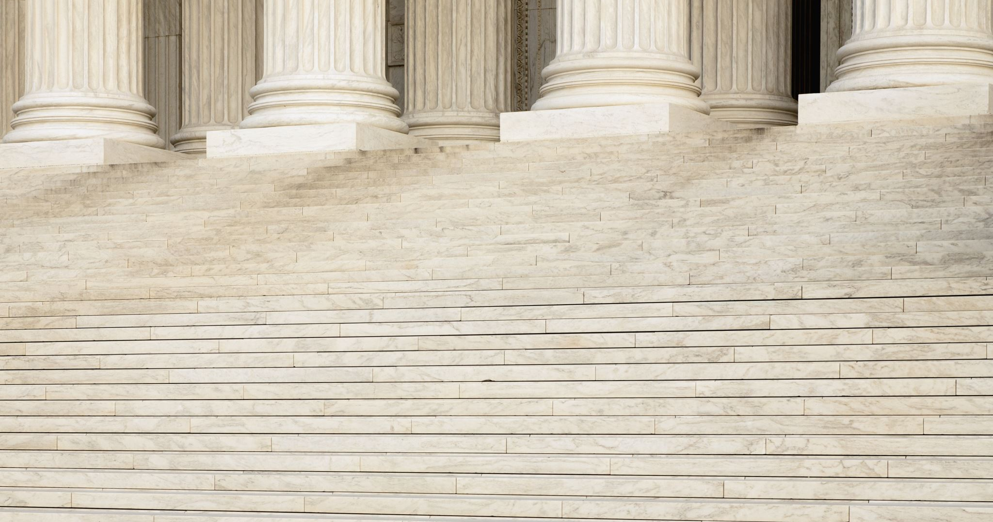
AHadith & Dua
Hadrat Ali ra related: Once I asked the Holy Prophet s.a.w. that if, after you, we face an issue for which there is no mention in the Holy Quran, and we have heard nothing on the subject from you; the Holy Prophet s.a.w. said: Assemble the pious from my Ummah and decide the issue through mutual consultation; do not make your decision over one man’s opinion. (Essential Guidelines for Shura, Wakalat Tabshir, pg. 3)

Slide 22
REFERENCES
The System of Mushawarat
Essential Guidelines for Shura, Wakalat Tabshir,

